Slide 1
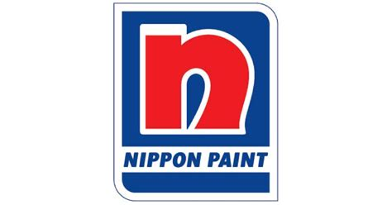

NIPPON PAINT INDIA LTD.
Summer Internship Presentation
WEBSITE SEO & DIGITAL MEDIA STRATEGY FOR IPL2021
Under the guidance of
Mr. Naveen Viswambharan Digital Marketing Manager Nippon Paint |  | Prof. Pankaj Singh Assistant Professor – HRM & OB IIM Raipur
-Submitted by
Padhmaja K
20PGP138

Slide 2
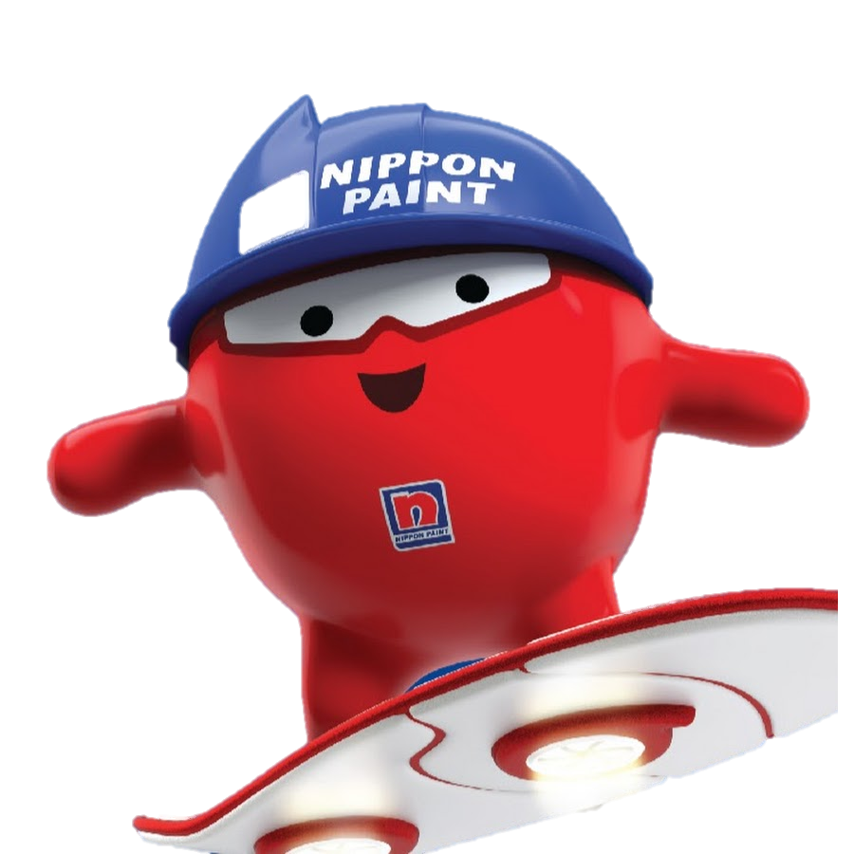
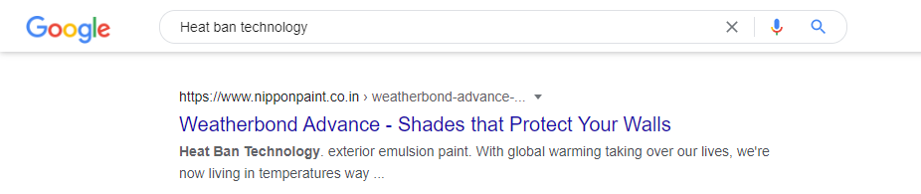

About the Company
The Social Handles – Followers
Instagram – 11.8k
Facebook – 51.k
Twitter – 6k
Found in 1881 , Japan
Brand Ambassador – “ The Nippon Blobby”
Only solution provider for all kind of surfaces
Auto, Marine, Protective, Decorative, Industrial
Heat Ban Technology – Nippon’s Ranked Number one in Google
15th Year into the market in India
Market Leaders
No | Company Name
1 | Asian Paints Ltd
2 | Berger Paints India Ltd
3 | Kansai Nerolac Paints Ltd
4 | Akzo Nobel India Ltd
5 | Nippon Paint (India) Private Limited
6 | Shalimar Paints Ltd
NIPPON means Land of Rising Sun – “Japan”

Slide 3
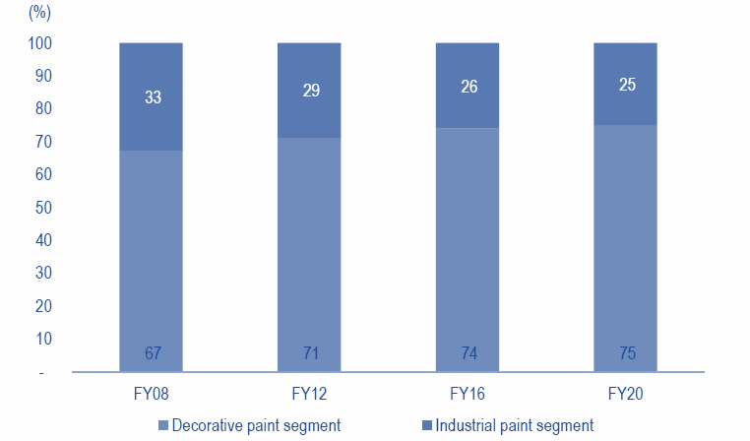
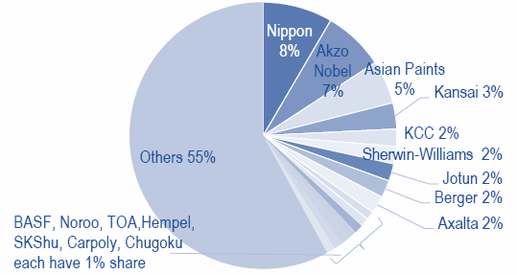
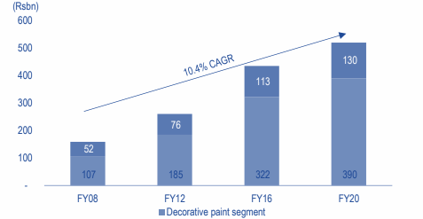
Industry Analysis
Segmentation
Decorative Segment
Industrial Segment
Market Leaders - TN
Asian Paints , followed by Nippon
Market Leaders - ASIA
Decorative Segment – ASIAN PAINTS
Industrial Segment - NEROLAC PAINTS
Nippon Paint – Asia’s Real Number one paint
CAGR ‘15%’

Slide 4
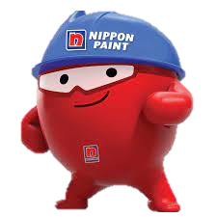
Project Details
WHY?
HOW?
RESULT
Formulating Ideas for IPL 2021 Campaign
Sports Marketing has its own reach to the audience.
Research on best possible ways
Came up with 10 Different Campaigns
Analysing the Ads and Post
- Past trends
- Further Improvements
1. Strategic
2. Tactical
The engagement ratio is very less comparatively
Identifying the Problems with the Website
The Consumer journey should be smooth
Public Opinion
Google Stats
Darker colours
Slow Loading
Less Interactive
Choosing the appropriate Keywords
The Appropriate Traffic – Improves sales
Optimal mix of Relevance, traffic and competition
Drive better traffic to the website – Increase in Sales

Slide 5
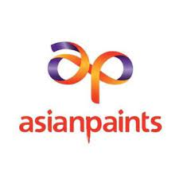
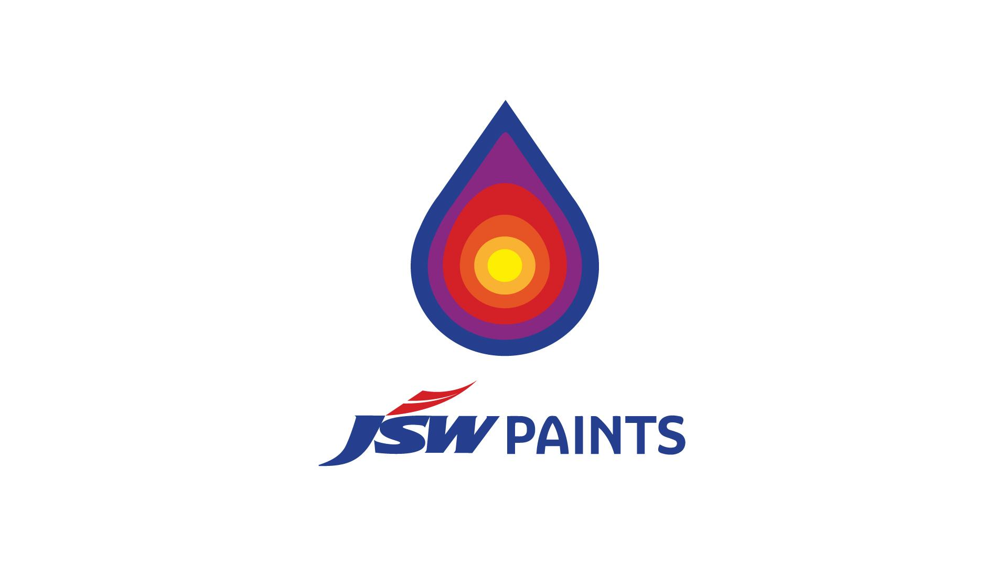
IPL is plays an important role for marketing in Indian Annual Calendar
The change – COVID’19 , Pushed in-stadium to in-home view.
Viewership of women has increased – Decorative Paints
#AsianPaintsHomeiswheretheheartis
Meet greet with Players
#Hargharkuchkehtahai
AP Homes
Target – East Market
 | Asian Paints | JSW Paints | Nippon
Sponsoring Team | KKR | DC | CSK, RCB
Sponsored Part | Lead Trousers | Chest | CSK – Non-Leading Arm RCB – Cap
Famous Previous Year Campaign | Meet Greet with Players | #Embraceverycolour | #NipponpoduWhistlepodu
Famous Campaigns by
the Competition -IPL
Special Jersey for the match with RCB
Har rang Har Kisi ka
Any color one price
IPL Sponsors

Slide 6
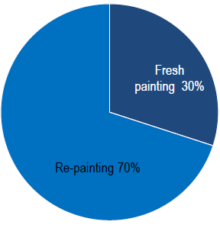
Improving Engagement in Social Media
Ideal Time : Posting : 12:00PM to 3PM Reposting : 12:00PM to 6PM
Instagram
Facebook
Twitter
Engagement Improvement
Use Stickers
Question Stickers
Tags
Reels engagement
Hashtags
Time to post
Badges
Use Post reactions
Create Eagerness (“One in 1000 can do this”)
Time to post
Favoriting your Tweet
Retweeting
Mentioning
Tweets with GIFS – 55% more engagement
Creating Hashtags
Running Campaigns
Defining & Refining a Particular Strategy
The Paint Industry – Expectations
Decorative Paints - Home Décor
WFH Need - Home Ambience given more importance
The Usage of Digital Media Boosted much – B2C can help

Slide 7
The Social Media Post and Ad Analysis
The Ad Analysis - Key Insights
The target audience of the particular Advertisement can be gauged .
The Digital World helps in target specific Customers
The TVC – Large Audience; the sales Funnel Ratio becomes Very less
The Nippon Paint Blobby is been used – Attracts people.
The Social Media Post Analysis – Key Insights
The Marketing Campaigns are Target Specific
The engagement is measured using likes, comments, shares
The competitors ratios are better indicating Dead Followers
The presence of CTA’s are not found.
Music & Colours
Key Constraint
Ad objective
Expressions
Characters Used
Improvement
Facebook | The Engagement Ratio is Optimum. Dead Followers
Instagram | The Competitors pages have better engagement follower ratios .
Twitter | Break during a period. The Engagement is much better
IPL Digital Media Marketing
Desired Change
Functional Emotional Benefits

Slide 8
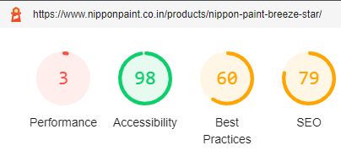
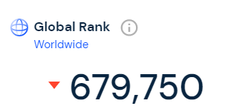
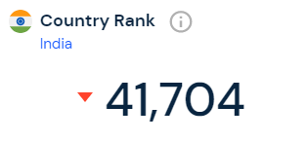
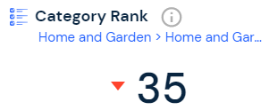
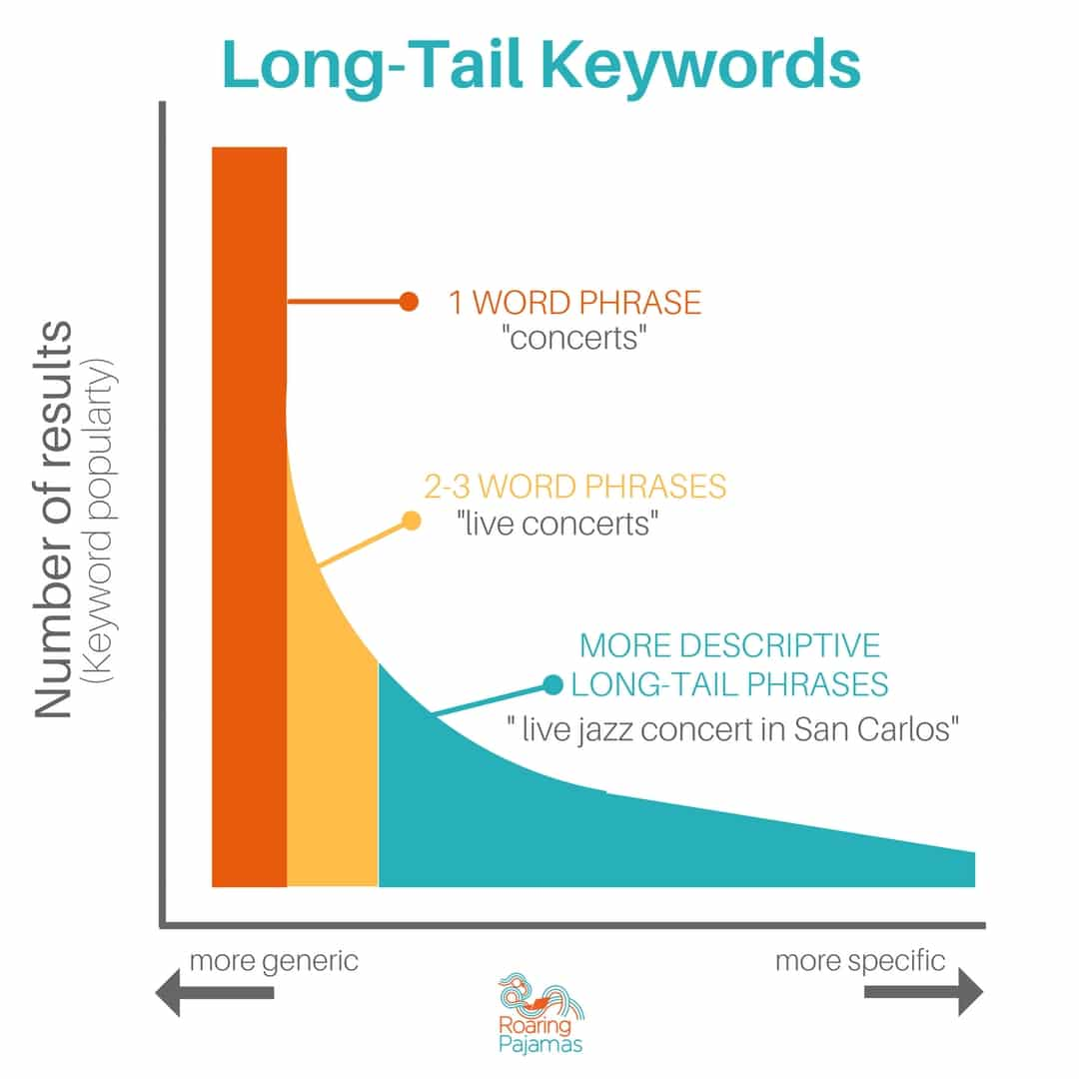
The Keyword Choice
The Importance
Of Keywords
Better Traffic
Better Indexing
Better Crawling
Increased Sales
Match Content
Performance Metrics
First Content Paint | 9.8 s
Speed Index | 21.9 s
Largest Content Paint | 11.6 s
Time To interactive | 25.5 s
Total Blocking Time | 1680ms
Cumulative Layout Shift | 0.348
Problems with The Website
The Keywords are selected based on the following parameters
Relevance: Greater the relevance, Higher Priority.
Back Links: The Greater links generated more higher is the search result on google.
Competition: The keywords with lesser competition can help crawl more.
Volume (Popularity): The volume of the search should be higher.
CPC: The Cost Per Click is higher for more demanding Keywords.
SEO Problems
Absence of Meta Description
Robots.txt valid
Links are not Crawlable

Slide 9
Recommendations
TVC and YouTube Ads
Social Media Posts
Website & SEO
Emphasize on the emotions
The functional benefits - Use
Colors Chosen – Pleasant
Using Celebrities to get better reach
Use Call to Actions.
Reposting and Retweets
Proper Patterned Profiles
Proper Choice – Hashtags
Link Building – Website
Use Long Tail Keywords
Faster And Mobile Friendly
Use Meta-Descriptions
Reduce Bounce Rates
Use Alt Text for Images

Slide 10
Thankyou !
“ If you could say it in words, there would be no reason to PAINT”

